Slide 1
Kentucky Transportation Center Research Efforts
A Review of UK’s Current & Recently Completed Utilities and Railroad Research
Roy Sturgill, Jr., P.E. (Roy.Sturgill@uky.edu)
Tim Taylor, P.E., Ph.D. (tim.taylor@uky.edu)
Kentucky Transportation Cabinet
Kentucky Transportation Center

Slide 2
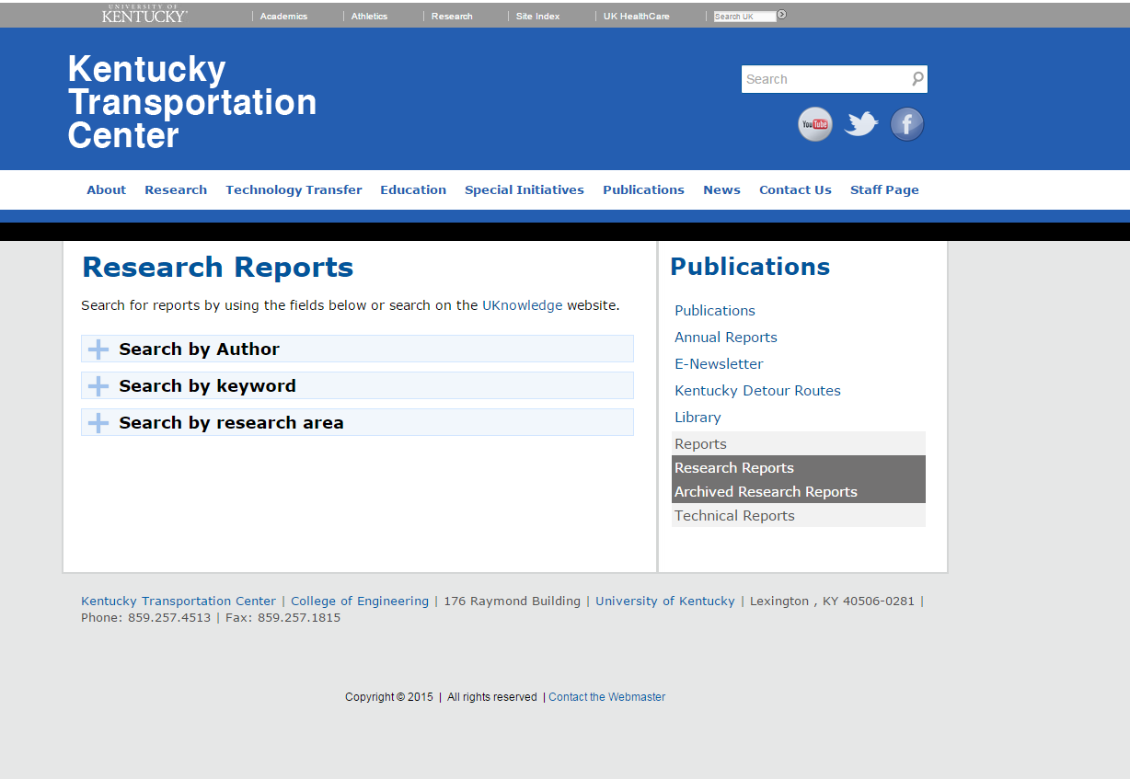
Access to UK KTC’s Research Reports
http://www.ktc.uky.edu/publications/reports/
Kentucky Transportation Cabinet
Kentucky Transportation Center

Slide 3
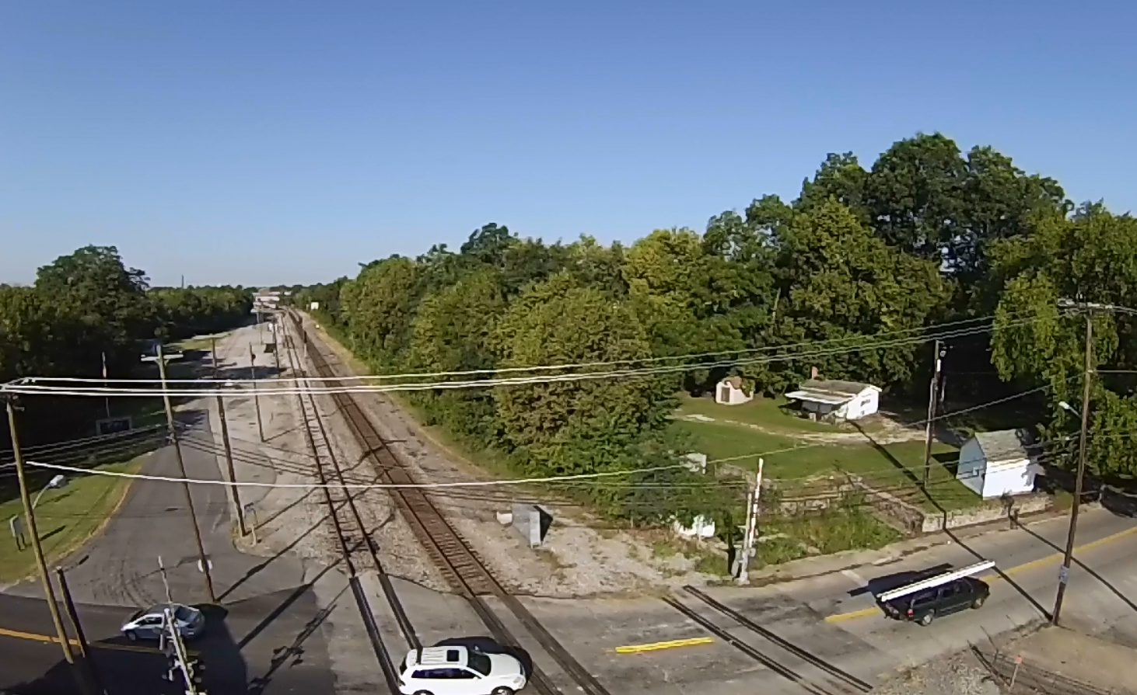
Presentation Overview
Utilities
Railroad
National Research Trends
UK’s Recently Completed
UK’s Current Efforts
Kentucky Transportation Cabinet
Kentucky Transportation Center

Slide 4
National Utility Research Trends
FHWA EDC-1 Flexibilities in Utility Accommodation and Relocation
SHRP 2-R01 Encouraging Innovation in Locating and Characterizing Underground Utilities
SHRP 2-R15(B) Identification of Utility Conflicts and Solutions
Utility Risk Management/Matrix
Optimizing Savings in Utility Management
Utility Management within Alternative Delivery Contract Methods
Kentucky Transportation Cabinet
Kentucky Transportation Center

Slide 5
UK’s Recently Completed Utility Research
Methods to Expedite and Streamline Utility Relocations for Road Projects
Describe and map the current Cabinet processes for identifying, planning, and executing needed utility relocations in support of KYTC highway projects,
Identify successful utility relocation management practices and processes at other state transportation agencies and other construction owners,
Design modifications to the current Cabinet processes for identifying, planning, and executing utility relocations to improve the efficiency of the process, and
Prepare implementation guidance throughout the research project to assist the Cabinet in adopting the new process and any associated technologies.
Kentucky Transportation Cabinet
Kentucky Transportation Center

Slide 6
UK’s Recently Completed Utility Research
KYTC’s interests:
Utility Relocation Causing Project Letting Delays or Construction Impacts
Increases construction costs; either through inflation or utility impacts
Division of Right of Way and Utilities Interested in a Synthesis of Best Practices and Strategies with Associated Guidance
Interest by Cabinet Leadership to Pose Solutions
New Practices Incorporating Consultant Efforts
Kentucky Transportation Cabinet
Kentucky Transportation Center

Slide 7
UK’s Recently Completed Utility Research
KTC Provided:
~Resources Reviewed & Best Practices Collected
30 STA Utility Manuals
Various Organization Guidance Resources
FHWA, AASHTO, NCHRP
Legislation & Regulations
~Participated in KYTC Task Force on Utility Relocation
~Interviews of Professionals (Utility Companies & Design Professionals)
~Surveys & Polls on the Topic along with Data Analysis
Kentucky Transportation Cabinet
Kentucky Transportation Center

Slide 8
UK’s Recently Completed Utility Research
Guidance Development for Best Practices
SWOT Analysis
Issue Resolution
Risk Alignment
(Continuing Effort)
Project Issue | Helpful Tools | Potential Benefits & Concerns
Overhead Utility Relocations & Associated Delays | Early Involvement & Communication | Engineering and relocation begins as soon as possible and parties are able to plan or apply other tools accordingly
 | Investigate temporary relocations | May simply push delays back; may incur additional costs
 | Establish a Utility Corridor | Could ease the engineering process if done appropriately; may not satisfy all needs
 | Separate or Service Contract for Clearing & Grubbing | Could speed the relocation process; could entail erosions concerns
 | Utility Impact Notes | Allows the project to go to letting and work to begin; if the dates noted slip, could result in delay charges to the KYTC
 | Incentives for Non-Reimbursable Utilities | Could incentivize utilities to relocate; some companies will not view the incentive as prosperous; use with caution
 | KYTC design of Utility Facilities | This could speed engineering; may be difficult finding qualified designers and utility companies may not allow it
Kentucky Transportation Cabinet
Kentucky Transportation Center

Slide 9
UK’s Recently Completed Utility Research
Risk Analysis & Model Development
Preconstruction Data Regression Analysis (1,966 applicable records)
Developed Methods to Assign Risk
Utility Phase $, Number of Utilities, Duration of Utilities (3 methods)
Risk Level | Number of Projects Per Risk Level (1,966 Total)
Low (1) | 836 (42.5%)
Medium (2) | 745 (37.9%)
High (3) | 385 (19.6%)
Kentucky Transportation Cabinet
Kentucky Transportation Center

Slide 10
UK’s Recently Completed Utility Research
Risk Analysis & Model Development
Risk Level | Number of Utilities Involved
Low (1) | Less than 3
Medium (2) | Between 3 and 6
High (3) | Greater than 6
Risk Level | Utility Phase Authorized Amount
Low (1) | Less than $300,000
Medium (2) | Between $300,000 and $600,000
High (3) | Greater than $600,000
Risk Level | Description for Utility Duration
Low (1) | Less than 365 days (1 year)
Medium (2) | Between 365 and 1095 days (3 years)
High (3) | Greater than 1095 days
Kentucky Transportation Cabinet
Kentucky Transportation Center

Slide 11
UK’s Recently Completed Utility Research
Risk Analysis & Model Development
Preconstruction Data Regression Analysis
R-Squared Value 0.84
$$Risk= 1.14−0.02∗District−0.00∗Type Bridge Replacement \left(1 or 0\right)+0.45∗Type Design Engineering\left(1 or 0\right)−0.09∗ Type I−Change Reconst\left(1 or 0\right)+0.13∗Type Major Widening \left(1 or 0\right)+0.68∗Type Minor Widening \left(1 or 0\right)−0.11∗Type New Interchange\left(1 or 0\right)+0.58∗Type Reconstruction \left(1 or 0\right)+0.07∗Type Safety\left(1 or 0\right)+0.36 Type Safety−Hazard Elim\left(1 or 0\right)+0.00∗Type Spot Improvements\left(1 or 0\right)+0.02∗Phase Autorization \left(in \$100,000\right)+0.13∗Number of Utilities Involved$$
Kentucky Transportation Cabinet
Kentucky Transportation Center

Slide 12
UK’s Recently Completed Utility Research
Best Practice & Risk Alignment
Tool | Appropriate Risk Level | Strengths | Weaknesses | Opportunities | Threats
Early Utility Involvement in Design | 1,2,3 | Early Incorporate utility knowledge in design process Early identification of potential utility issues Better coordinated | Level of effort increases for utility staff early in project | Time savings from better coordination Money savings form avoiding potential issues | More involvement could slow early design
Training project managers and other design personnel on utility issues | 1,2,3 | Sufficient knowledge with regards to utility relocation. Better and early identification of potential utility issue | Level of effort increases for manager and design personnel | Time and cost saving from better design Time and cost saving from better management Better coordination from more knowledge | Spending more cost and time for training
Kentucky Transportation Cabinet
Kentucky Transportation Center

Slide 13
TOOLS TO KNOW!!!
Project Report: Methods to Expedite and Streamline Utility Relocations for Road Projects
http://www.ktc.uky.edu/projects/methods-to-expedite-and-streamline-utility-relocations-for-road-projects/
Table 20 Utility Best Practice Toolkit Guidance
Using the equation or your judgement, classify the utility risk of your project and then review the associated best practices to mitigate those risks!
Table 21 Project Utility Issues Aligned with Best Practices
Review utility best practices associated with specific project issues!
Kentucky Transportation Cabinet
Kentucky Transportation Center

Slide 14
TOOLS TO KNOW!!!
Top Ten Considerations for Expediting Utility Relocations
Early Utility Involvement
Communicate & Coordinate Actively (multiple areas)
Put a Utility Expert on the Team
Use SUE (requires thorough understanding)
Training (utilities in highway design & vice versa)
Electronic Utility Tracking *See KURTS
Use Utility Corridors/Duct Banks (when appropriate)
Consider Utilities in ROW Acquisition
Avoidance (have to know where they are!)
Reimbursement for early relocation (use with care)
Kentucky Transportation Cabinet
Kentucky Transportation Center

Slide 15
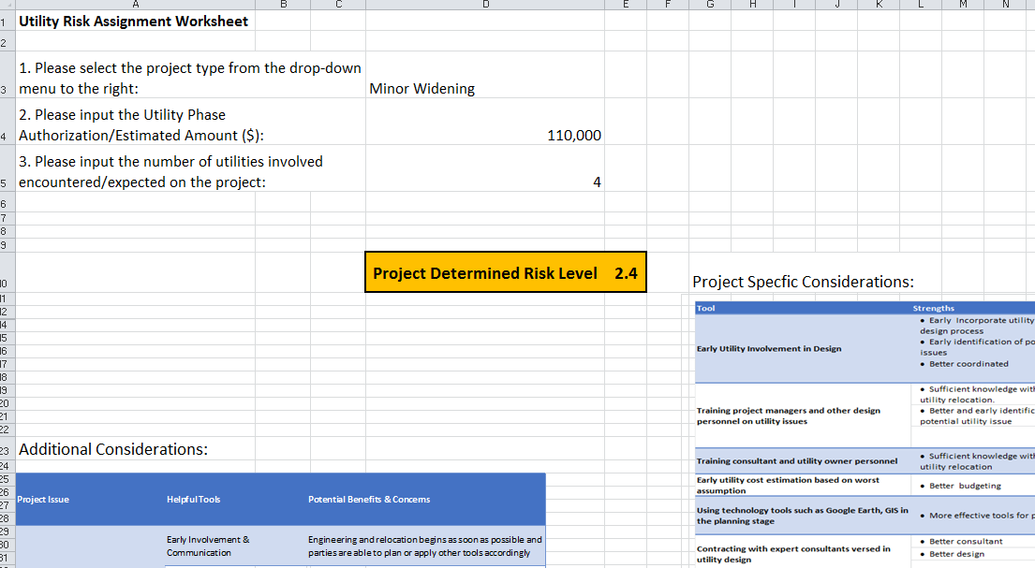
UK’s Current Utility Research
Utility Risk Tool ~Available Soon
Kentucky Transportation Cabinet
Kentucky Transportation Center

Slide 16
UK’s Current Utility Research
Utilities Coordination Review for ORB
Aligns with some national trends to look at Utility Coordination in Alternative Delivery Methods
Utility Training (In Discussion)
Plan reading training, specific to KYTC projects
Training with KYTC Designers & Consultants on Utility Coordination Best Practices
Kentucky Transportation Cabinet
Kentucky Transportation Center

Slide 17
UK’s Current Utility Research
Utilities Coordination Review for ORB
Downtown sections:
94 conflicts with 15 Utility Companies (6 Kentucky and 9 Indiana)
Some avoided in the final design by the DBT; leaving 81 relocations completed on-time and on-budget
East end sections:
57 conflicts with 17 Utility companies (6 Kentucky and 11 Indiana)
INDOT completed 11 preliminary engineering agreements in the amount of $854K and,
25 of the utility conflicts were relocated prior to the P3 developer being procured
Budget for this advance utility relocation work was $3.5 million with only $3.0 million actually spent
All relocations were completed without delay or claims.
Kentucky Transportation Cabinet
Kentucky Transportation Center

Slide 18
UK’s Current Utility Research
Utilities Coordination Review for ORB
Current Findings:
Kentucky ~ DBT used two methods
Similar to 2 and 3 below
INDOT ~P3 Developer used three methods
Type 1: Relocations prior to P3 using concept plans
Type 2: Utility works with P3 Developer to relocate
Type 3: Utility relocates but coordinates with P3 Developer
Kentucky Transportation Cabinet
Kentucky Transportation Center

Slide 19
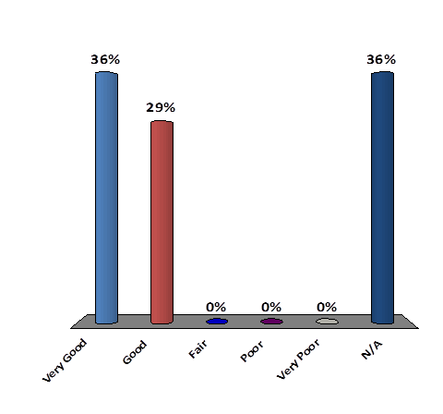
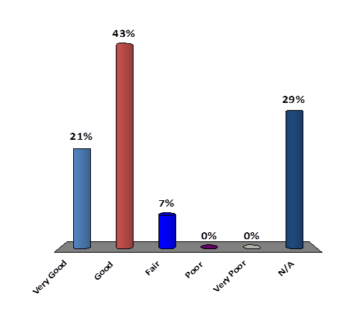
UK’s Current Utility Research
Utilities Coordination Review for ORB
Current Findings: Level of Success working with DBT or P3 Developer
Kentucky Transportation Cabinet
Kentucky Transportation Center

Slide 20
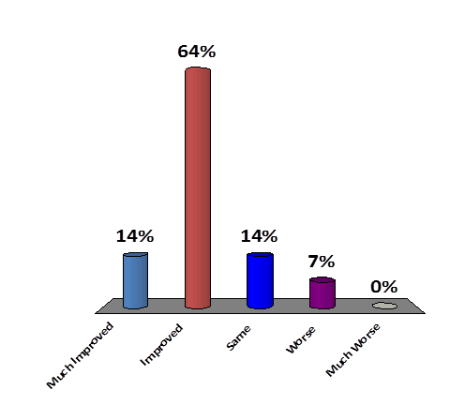
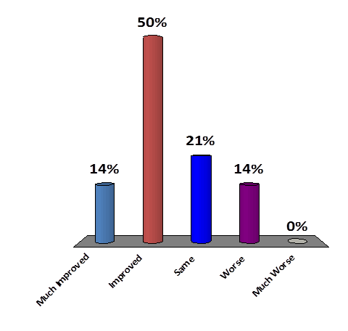
UK’s Current Utility Research
Utilities Coordination Review for ORB
Current Findings ~ Compared to DBB (asked two ways)
Kentucky Transportation Cabinet
Kentucky Transportation Center

Slide 21
UK’s Current Utility Research
Utilities Coordination Review for ORB
Current Findings: ~ Open Discussion
Of the DBT & P3 Developer
Excellent Communication
Professionalism
Conflict Resolution
DESIGN-BUILD/P3 allows:
More Utility Accommodation & Coordination
Better Utility Construction Timelines
Kentucky Transportation Cabinet
Kentucky Transportation Center

Slide 22
KTC Railroad Research Program
Reg Souleyrette, P.E., Ph.D.
Souleyrette@uky.edu
Bryan Gibson, Ph.D.
bryan.gibson@uky.edu
Not Pictured
Jerry Rose, P.E., Ph.D. Jerry.Rose@uky.edu
Alex Wang wangtengyilang@uky.edu
Kentucky Transportation Cabinet
Kentucky Transportation Center

Slide 23
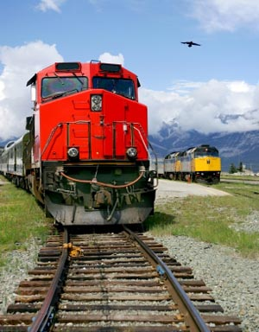
Railroad Research
National Research Trends
UK’s Recently Completed
UK’s Current Efforts
Kentucky Transportation Cabinet
Kentucky Transportation Center

Slide 24
National Railroad Research Trends (Related to Highways)
FHWA EDC-3 Improving DOT and Railroad Coordination
SHRP 2-R16 Strategies for Improving the Project Agreement Process Between Public Agencies and Railroads
At-Grade Railway/Highway Crossing
Safety
Evaluation & Prioritization
Kentucky Transportation Cabinet
Kentucky Transportation Center

Slide 25
Rail/Highway At-Grade Crossing Reports
Effect of Enhanced Trackbed Support on Railway/Highway At-Grade Crossing Performance
Results indicate that asphalt underlayment extends the service life of crossings and improves their performance.
Railway/Highway At-Grade Crossing Surface Management: An Overview
Describes the features of a successful railway/highway at-grade crossing management program
Kentucky Transportation Cabinet
Kentucky Transportation Center

Slide 26
Highway Rail Crossing Prioritization
Operationalize recent rail/highway at-grade crossing research
Combines qualitative measures of crossing conditions with quantitative measures including proposed project costs and a valuation of the crossing based on rail and truck traffic
Kentucky Transportation Cabinet
Kentucky Transportation Center

Slide 27
Highway Rail Crossing Prioritization
Two-part tool
Rail-crossing questionnaire (Word)
Rail scoring worksheet (Excel)
Programmatic approach to rail crossing management
http://www.ktc.uky.edu/research/public-transit-rail-water/rail/
Kentucky Transportation Cabinet
Kentucky Transportation Center

Slide 28
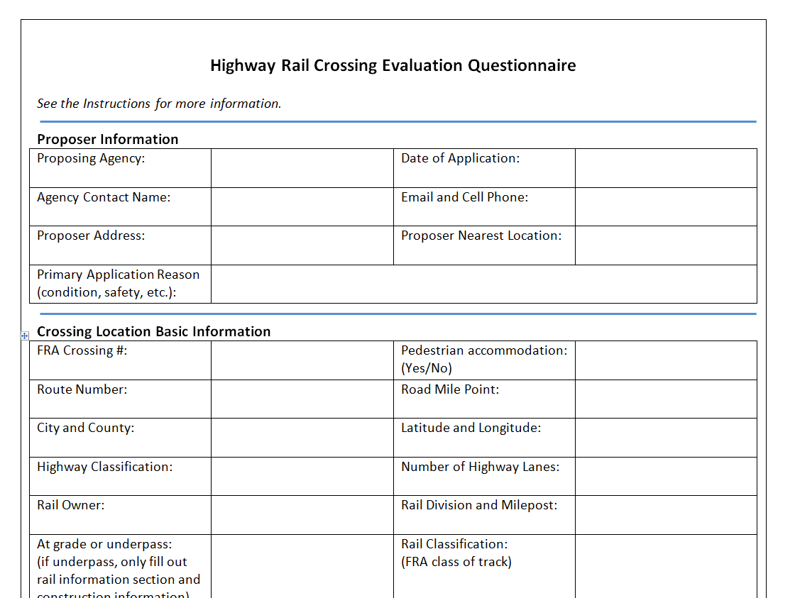
Rail-crossing questionnaire
Information about project, crossing safety (WBAPS), and a qualitative assessment of crossing
Kentucky Transportation Cabinet
Kentucky Transportation Center

Slide 29
Rail scoring worksheet
Scoring workbook
Index (qualitative assessments from questionnaire), economic valuation (valuation of traffic and cost of improvement), and total ranking
Kentucky Transportation Cabinet
Kentucky Transportation Center

Slide 30
Rail scoring worksheet
Blue areas indicate user inputs
Prioritization Output
Kentucky Transportation Cabinet
Kentucky Transportation Center

Slide 31
UK’s Current Railroad Research
Modeling At-Grade Highway Crossings
Using various methods to compare technologies and analyze accuracy
Aerial photo & video
UAS/UAV capturing
LiDAR
Instrumented Railcars
Kentucky Transportation Cabinet
Kentucky Transportation Center

Slide 32
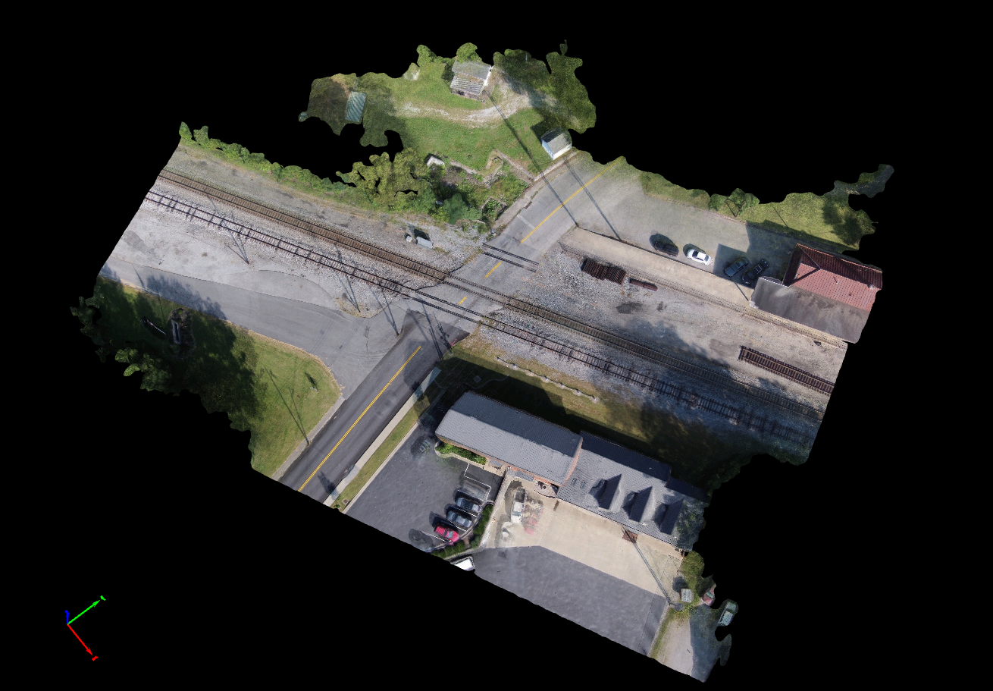
UK’s Current Railroad Research
Modeling At-Grade Highway Crossings
Kentucky Transportation Cabinet
Kentucky Transportation Center

Slide 33
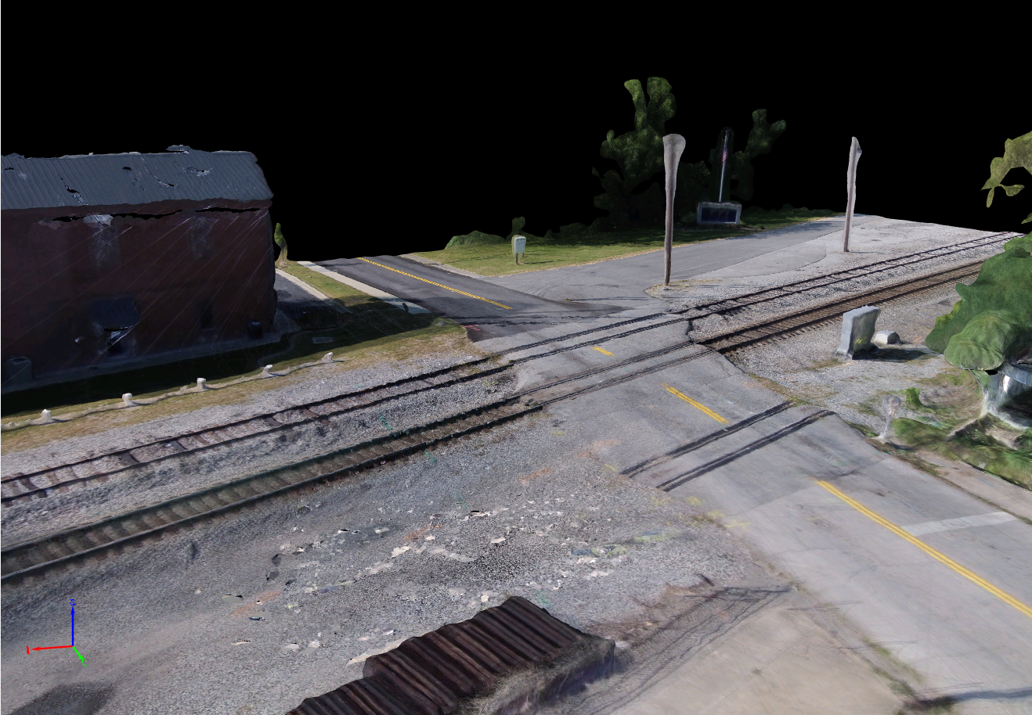
UK’s Current Railroad Research
Modeling At-Grade Highway Crossings
Kentucky Transportation Cabinet
Kentucky Transportation Center

Slide 34
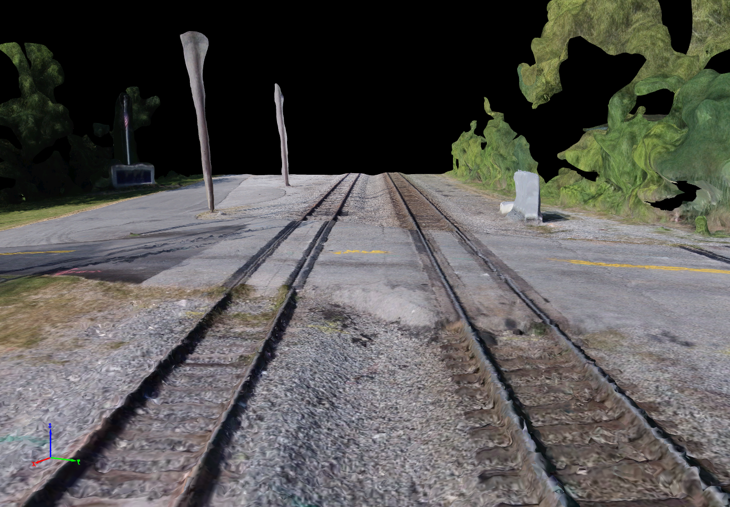
UK’s Current Railroad Research
Modeling At-Grade Highway Crossings
Kentucky Transportation Cabinet
Kentucky Transportation Center

Slide 35
Questions & Comments
Kentucky Transportation Cabinet
Kentucky Transportation Center

